Slide 1

Artificial Intelligence
5 ADVERSARIAL SEARCH
Russell & Norvig, AI: A Modern Approach, 3rd Ed

Slide 2
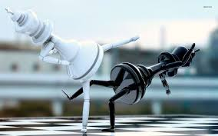
Objectives
Learning how to act when the other agents are
acting against us

Slide 3
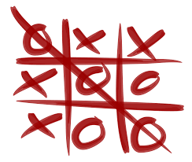
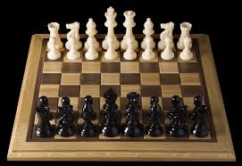
Games

Slide 4
Games vs. Search
Search – no adversary
Examples: path planning, scheduling activities
Games – adversary
Unpredictable opponent(s)
Solution is strategy (strategy specifies move for every possible opponent reply).
Time limits force an approximate solution
Inefficiency is intolerable

Slide 5
Zero Sum Game
Total pay off to all players is the same for every instance of games
Chess/Tic-tac-toe:
Win – 1
Lose – 0
Draw – ½

Slide 6
Assumptions
Two agents acting alternately
Utility values for each agent are the opposite of the other
Deterministic
Fully observable
Can generalize to stochastic games, multiple players, non zero-sum, etc
In game theory terms:
“Deterministic, turn-taking, zero-sum games of perfect information”

Slide 7
Games as search
Initial state: e.g. board configuration of chess
Player: which player to give the current move
Successor function: list of (move, state) pairs specifying legal moves.
Terminal test: Is the game finished?
Utility function: Gives numerical value of terminal states. E.g. win (+1), lose (-1) and draw (0) in tic-tac-toe or chess

Slide 8
Game Setup
Two players: MAX and MIN
MAX tries to maximize the utility
MAX moves first and they take turns until the game is over
MAX uses search tree to determine next move.
We plan as MAX

Slide 9
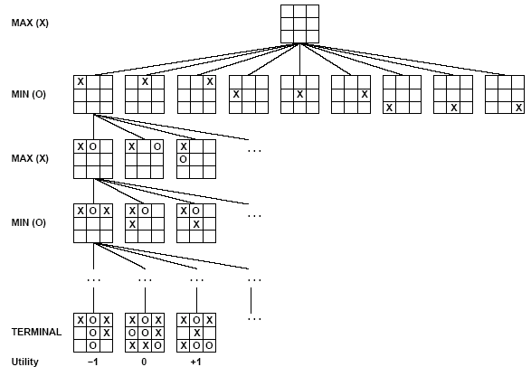
Partial Game Tree for Tic-Tac-Toe

Slide 10
Size of search trees
b = branching factor
d = number of moves by both players
Search tree is O(b^{d})
Chess
b ~ 35
D ~ 100 (50 moves on average by each player)
- search tree is ~ 35 ¹⁰⁰ OR 10 ¹⁵⁴ (!!)
- Although the search graph has only 10 ⁴⁰ distinct nodes
- completely impractical to search this
Game-playing emphasizes being able to make optimal decisions in a finite amount of time

Slide 11
Optimal Strategy
An optimal strategy leads to outcomes at least as good as any other strategy when the opponent plays optimally.

Slide 12
Strategy 1
The minimax algorithm

Slide 13
The minimax algorithm
Find the optimal strategy for MAX assuming an optimal MIN opponent
Assumption: Both players play optimally!

Slide 14
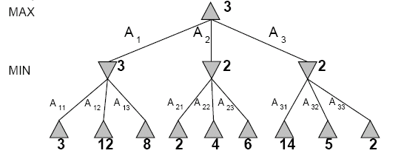
Two-Ply Game Tree

Slide 15
Two-Ply Game Tree

Slide 16
Two-Ply Game Tree

Slide 17
Two-Ply Game Tree
Minimax maximizes the utility for the worst-case outcome for max
The minimax decision

Slide 18
The minimax algorithm
Minimax value is the utility of MAX for being in the corresponding state
MINIMAX-VALUE(n)
UTILITY(n) If n is a terminal
max_{s ∈ successors(n)} MINIMAX-VALUE(s)
If n is a max node
min_{s ∈ successors(n)} MINIMAX-VALUE(s) If n is a min node

Slide 19
Minimax is done depth-first
max
min
max
leaf
2 5 1

Slide 20
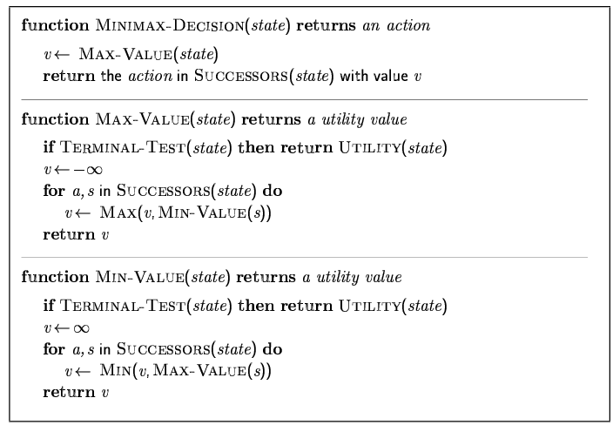
Minimax algorithm

Slide 21
Pseudocode for Minimax Game
MAX_VALUE(State s)
{
if s is terminating node
return value of s;
ans = - ∞
for c in successor of s
{
v = MIN_VALUE(c);
ans = max (v, ans); //find the maximum
}
return ans;
}
MIN_VALUE(State s)
{
if s is terminating node
return value of s;
ans = ∞
for c in successor of s
{
v = MAX_VALUE(c);
ans = min (v, ans); //find the minimum
}
return ans;
}
MIN_MAX_DECISION(State s)
{
return MAX_VALUE(s);
}

Slide 22
Properties of Minimax
Complete? Yes (if tree is finite)
Optimal? Yes (against an optimal opponent)
Time complexity? O(b^{m})
Space complexity? O(bm) (depth-first exploration)
For chess, b ≈ 35, m ≈100 for "reasonable" games → exact solution completely infeasible
Need to speed it up.

Slide 23
Strategy 2
Alpha Beta Pruning

Slide 24
Alpha-Beta Procedure
The alpha-beta procedure can speed up a depth-first minimax search.
Alpha: a lower bound on the value that a max node may ultimately be assigned
Beta: an upper bound on the value that a minimizing node may ultimately be assigned
v > α
v < β

Slide 25
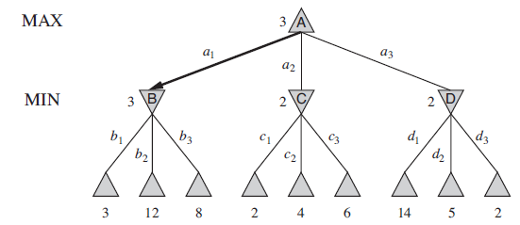
α-β pruning example

Slide 26
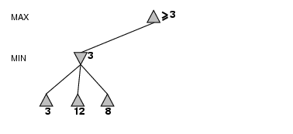
α-β pruning example

Slide 27
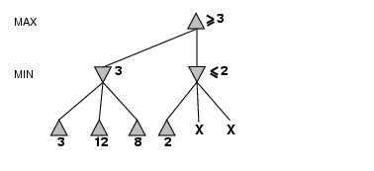
α-β pruning example
α = 3
alpha cutoff

Slide 28
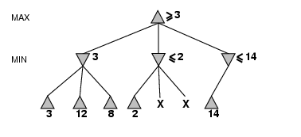
α-β pruning example

Slide 29
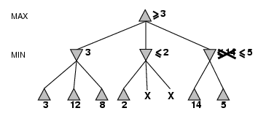
α-β pruning example

Slide 30
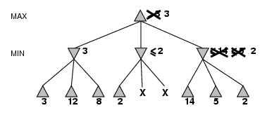
α-β pruning example

Slide 31
Properties of α-β
Pruning does not affect final result. This means that it gets the exact same result as does full minimax.
Good move ordering improves effectiveness of pruning
With "perfect ordering," time complexity = O(b^{m/2})
→ doubles efficiency of search

Slide 32
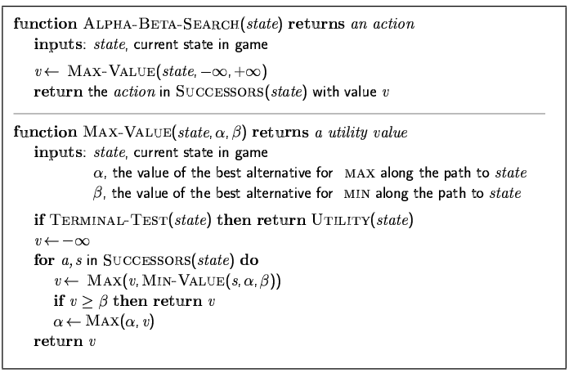
The α-β algorithm

Slide 33
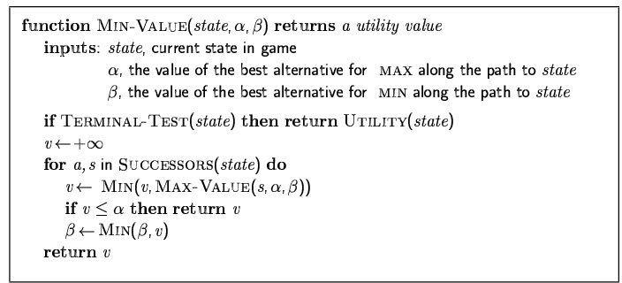
The α-β algorithm

Slide 34
Pseudocode for α-β algorithm
MAX_VALUE(State s, α, β)
{
if s is terminating node
return value of s;
for c in successor of s
{
x = MIN_VALUE(c, α, β);
if x ≥ α then α = x
if α ≥ β then break; // cut
}
return α;
}
MIN_VALUE(State s, α, β)
{
if s is terminating node
return value of s;
for c in successor of s
{
x = MAX_VALUE(c, α, β);
if x ≤ β then β = x;
if α ≥ β then break; // cut
}
return β;
}
MIN_MAX_DECISION(State s)
{
return MAX_VALUE(s, -∞, +∞);
}

Slide 35
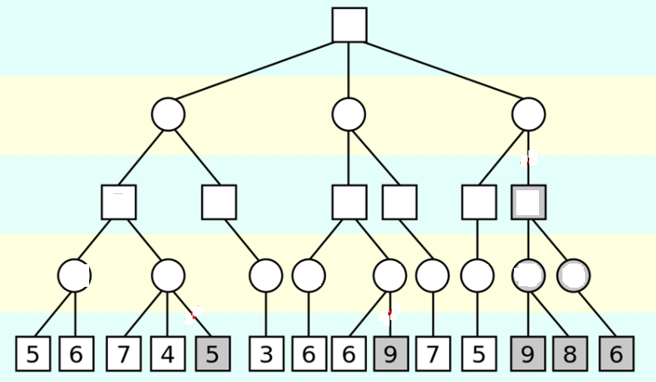
Example

Slide 36
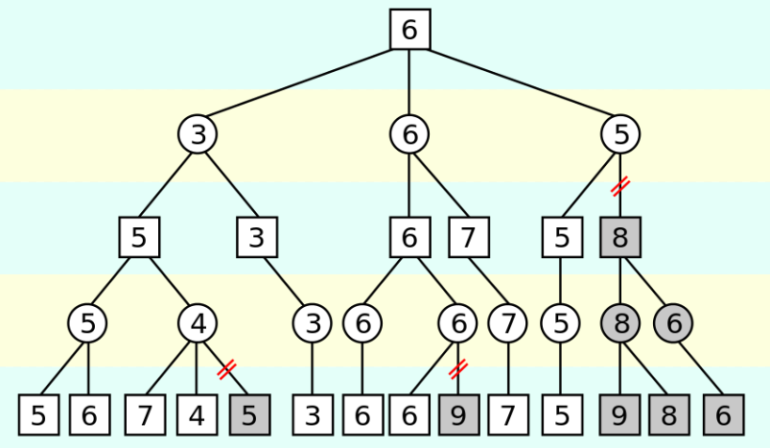
Example

Slide 37
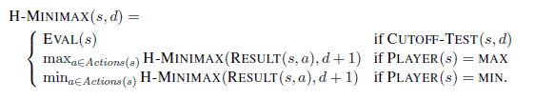
IMPERFECT REAL-TIME DECISIONS
EVALUATION Function:
Programs should cut off the search earlier and apply a heuristic evaluation function to states in the search, effectively turning nonterminal nodes into terminal leaves

Slide 38
IMPERFECT REAL-TIME DECISIONS
For example, suppose our experience suggests
72% of the states encountered in the two-pawns vs. one-pawn category lead to a win (utility+1);
20% to a loss (0), and
8% to a draw (1/2).
Then a reasonable evaluation for states in the category is the expected value: (0.72 × +1) + (0.20 × 0) + (0.08 × 1/2) = 0.76

Slide 39
IMPERFECT REAL-TIME DECISIONS
EVALUATION Function:
Evaluation functions work by calculating various features of the state. Like,
The number of white pawns, black pawns, white queens, black queens, and so on
Various categories or equivalence classes of states, Like: two-pawn vs. one-pawn endgames
Material value for each piece: each pawn is worth 1, a knight or bishop is worth 3, a rook 5, and the queen 9.

Slide 40

IMPERFECT REAL-TIME DECISIONS
where each wi is a weight and each fi is a feature of the position. For chess, the fi could be the numbers of each kind of piece on the board, and the wi could be the values of the pieces (1 for pawn, 3 for bishop, etc.).

Slide 41
IMPERFECT REAL-TIME DECISIONS
Problems:
Quiescence search: For identifying states that will not show wild swings in EVAL fn value in the near future.
Horizon effect: It arises when the program is facing an opponent’s move that causes serious damage and is ultimately unavoidable, but can be temporarily avoided by delaying tactics. Solution: Singular extension

Slide 42
IMPERFECT REAL-TIME DECISIONS
What about Search versus lookup?

Slide 43
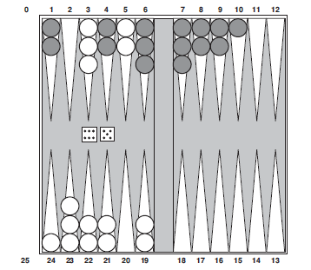
STOCHASTIC GAMES
Available moves: (5–10,5–11),
(5–11,19–24),
(5–10,10–16),
(5–11,11–16)

Slide 44
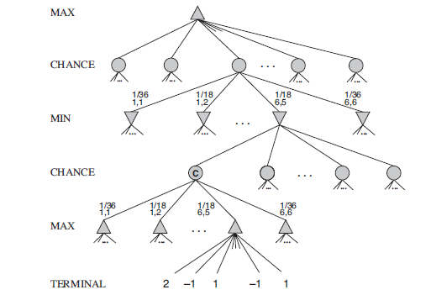
STOCHASTIC GAMES

Slide 45
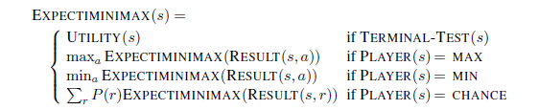
STOCHASTIC GAMES
r is possible dice roll

Slide 46
Thank you ☺

